Slide 1
Exploring the interaction of ecosystem processes and ecosystem services for effective decision-making
Alistair McVittie & Ioanna Siameti

Slide 2



Acknowledgements
Funded by NERC Valuing Nature Network with support from the Scottish Government’s Strategic Research Programme
Project team:
  SRUC:
    Alistair McVittie, Klaus Glenk, Ioanna Siameti
  James Hutton Institute:
    Julia Martin-Ortega, Wendy Kenyon, Matt Aitkenhead, Inge Alders, Rupert Hough, Helaina Black
  Centre for Ecology and Hydrology:
    Lisa Norton, Simon Smart, Francois Edwards, Mike Dunbar

Slide 3
Content
Motivation for study
Identifying ecosystem interactions
Developing an interdisciplinary model
Scenario results
Next steps
Summary

Slide 4
Motivation
Ecosystem services concept is increasingly being used as a framework for science and policy
A lot has been done to conceptualise the use of ES, but more required to operationalize ES for decision making
Need for interdisciplinary working
Better understanding of the links between ecosystem processes, services and benefits

Slide 5
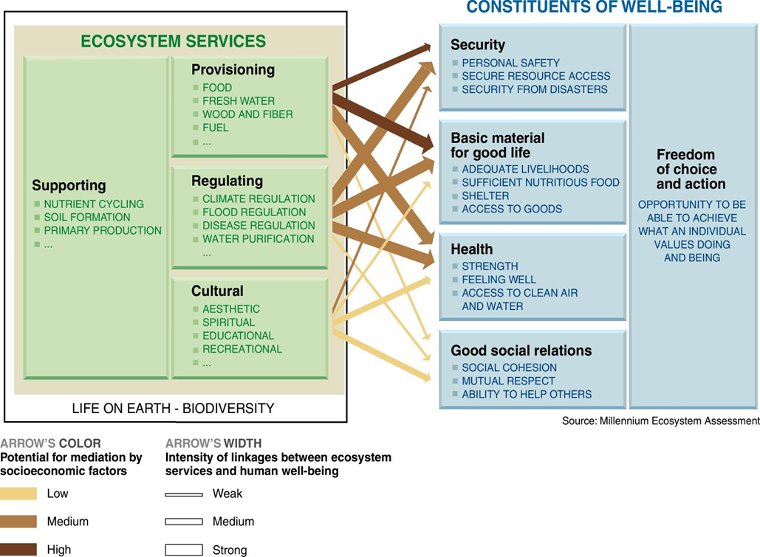
MEA framework

Slide 6
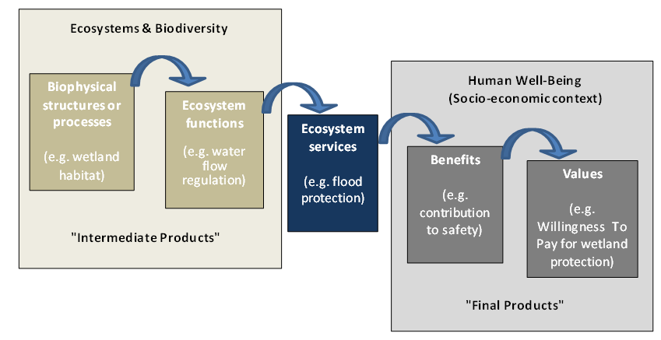
Ecosystem service cascade
Haynes-Young and Potschin, 2009

Slide 7
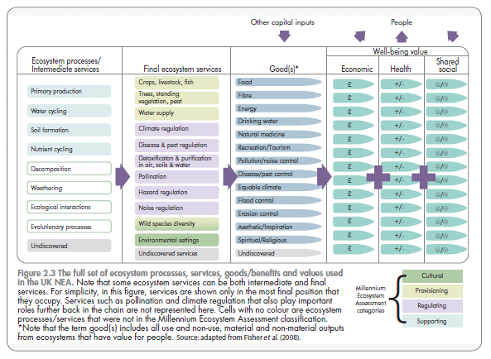
UK NEA framework

Slide 8
Identifying ecosystem interactions
Workshop of researchers and policy makers
Aim was to identify linkages between
  Ecosystem processes;
  Management interventions; and
  Four desired outcomes (ecosystem services):
    Sustainable crop yield
    Increased biodiversity
    Improved water quality
    Reduced flood damage

Slide 9
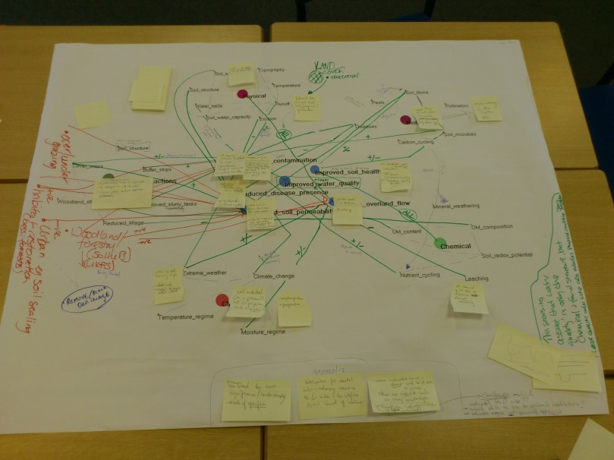
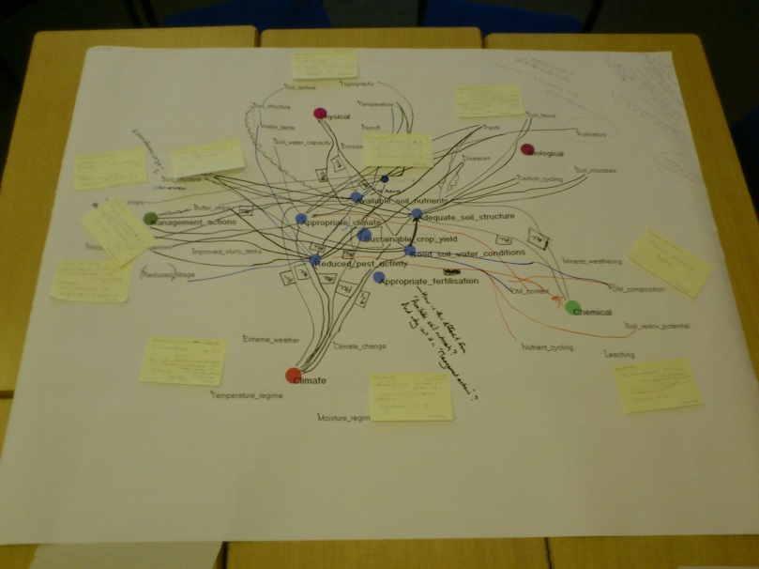
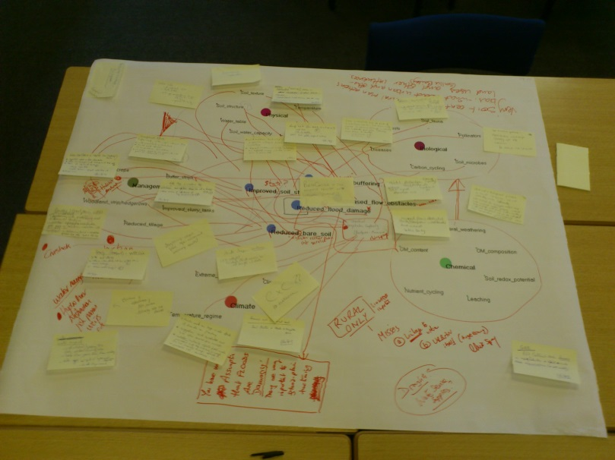
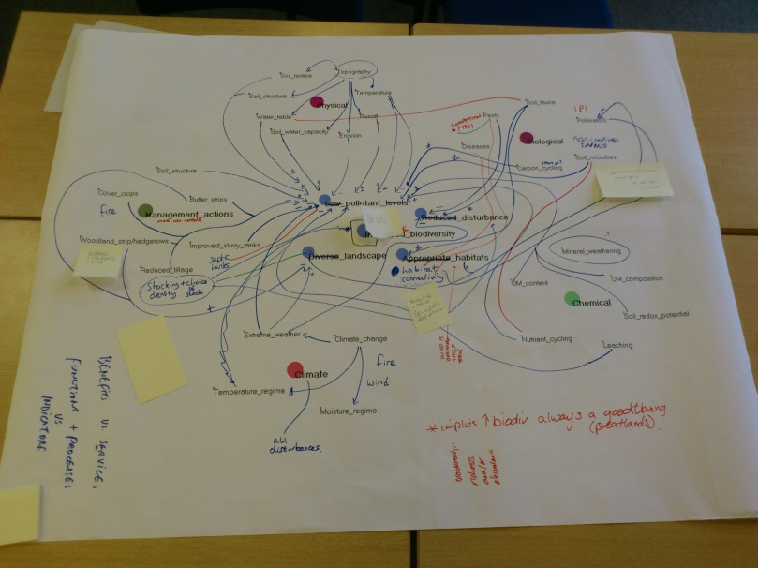
Identifying ecosystem interactions

Slide 10
Identifying ecosystem interactions
Attercap network analysis – Matt Aitkenhead, James Hutton Inst

Slide 11
Water quality mapping example
Attercap network analysis – Matt Aitkenhead, James Hutton Inst
Notes:
My two comments
“increased soil permeability” sits a little odd alongside the others which are more over arching. Is the permeability one included to reflect improved groundwater recharge as the benefit?
Improved soil health – why health? We don’t have indicators of soil health but we do have indicators of soil quality. It might seem like semantics but has important implications for what the aims / benefits are

Slide 12
Developing an interdisciplinary model
Even a single policy objective resulted in complex set of interactions
Needed to simplify the model or identify the key components
Needed an approach that was accessible to all team members
Decided to use Bayesian Belief Networks

Slide 13
What is a BBN?
Flood risk | Proximity | Welfare impact
High | Near | -100
High | Far | -20
Medium | Near | -60
Medium | Far | -10
Low | Near | -20
Low | Far | 0
 |  | Surface flow
Rainfall | Slope | High | Medium | Low
High | High | 100 | 0 | 0
High | Low | 20 | 60 | 20
Low | High | 20 | 20 | 60
Low | Low | 0 | 0 | 100

Slide 14
Developing a BBN
States of nature
Terrestrial processes
Management intervention
Aquatic
processes
Final ecosystem services
Values

Slide 15
Utility values
Flood risk | Water quality | Utility
Low | Blue (high) | 100
Low | Green (good) | 100
Low | Yellow (moderate) | 75
Low | Red (poor) | 50
Medium | Blue | 65
Medium | Green | 65
Medium | Yellow | 50
Medium | Red | 35
High | Blue | 50
High | Green | 50
High | Yellow | 25
High | Red | 0

Slide 16
Example scenarios
Scenario | Region | Land use | Soil type | Slope
A | East England | Arable | Light free draining (sandy) | Low
B | West England | Grassland | Heavy poorly draining (clay) | Medium
C | West England | Grassland | Heavy poorly draining (clay) | High

Slide 17
Model results: ‘utility’ values
Scenario | No buffer strips | Buffer strip management
 |  | Grass | Natural Vegetation | Mixed
A | 55.39 | 56.71 | 59.37 | 58.04
B | 55.61 | 58.23 | 59.91 | 59.07
C | 54.53 | 57.42 | 59.25 | 58.33

Slide 18
Changes in outcome probabilities
Scenario A |  | Status quo (%) | Grass (%) | Change in pr
Flood risk | Low | 28.6 | 35.2 | 6.6
 | Medium | 48.6 | 46.8 | -1.8
 | High | 22.8 | 18.0 | -4.8
Water quality | Blue | 22.2 | 25.1 | 2.9
 | Green | 31.6 | 32.2 | 0.6
 | Yellow | 28.5 | 27.0 | -1.5
 | Red | 17.6 | 15.7 | -1.9

Slide 19
Expanding the BBN
States of nature
Terrestrial processes
Management intervention
Aquatic
processes
Final ecosystem services
Preferences
Values

Slide 20
Combing different models
Land management
Land cover
Weather
Lake nutrient status
Nutrient load model
(PLANET)
Runoff model (GWLF)
Algal production model (PROTECH)
Cost
Water quality
Buffer strips
Presence/
absence
Location
Extent
Species
Vegetation cover
Wild species diversity
Landscape amenity
Climate regulation
Carbon storage
Notes:
THIS SLIDES CONTAINS ANIMATION
The Bayesian Belief Network approach allows considerable flexibility in the types of data and knowledge used. In this slide we demonstrate how the BBN approach could be used to expand on existing biophysical process models. In this example – a case study of Loweswater in the Lake District a number of process models were developed or parameterised by CEH and others under the RELU programme. The models describe the phosphorus cycle within the catchments linking nutrient cycling on farms (click) potential runoff (click) and an algal production within the lake (click) which describes water quality.
These models can potentially be integrated into a BBN that also includes initial system states (click), other relevant ecosystem processes and services and benefits that can be values. As with the previous model we are interested in the impact of buffer strips as a management action (click) where these might have a number of important characteristics such as location within the catchment, extent, species and composition etc. (click). The buffer strips will interact with the system to influence both the processes and produce a range of ecosystem goods and services that might in turn be valued (click).
Here we illustrate a wider range of end points that might be valued, including potential costs to farmers of installation and lost production due to the buffer strips. This highlights the potential for trade-offs or synergies in multiple outcomes that will affect values.
The key flexibility of the BBN approach is that whilst in this example there is very well defined context and models available with respect to the water quality impact that utilise detailed process models, our understanding of the processes underlying some of the other valuation endpoints might be less well understood. We are still able to combine these data sources whilst acknowledging the residual uncertainties. Specifically the components of the BBN rely on probabilistic relationships so uncertainty is inherent in the outcomes. A useful future research activity would be to use these models directly in valuation exercises to explore the impact of this uncertainty on values.

Slide 21
Benefits of the approach
Provides an opportunity to develop joint knowledge and understanding of the system
Diagrammatic allows easily visualisation of the system
Doesn’t require precise knowledge of biophysical or socio-economic relationships
Can combine both quantitative and qualitative information
Degree of complexity can be kept to reasonable level
  due to types of data used; and
  working back from outcomes of interest
BBN software is relatively easy to operate

Slide 22
Issues
Do ‘utility’ values need to be linked to actual values, or are weights sufficient?
Probabilistic outcomes may reflect inherent uncertainty in ecosystems, but:
  How do we apportion values across outcomes (e.g. benefit transfer)?
  How do we account for uncertainty in both outcomes and values?
  Are there important thresholds for preferences?
How, or can, we integrate values across multiple services?
Statistical measures such as confidence intervals desirable
Risks becoming a ‘black box’ in decision making
  Need for stakeholder involvement in model building?

